Slide 1
Premier League Tactical Identity & Evolution (21–25)
Data by Opta from Stats Perform
Data Analytics End to End Project by António Gouveia powered by Gemini
for Ironhack Data Analytics Bootcamp
Notes:
Os conteúdos gerados por IA poderão estar incorretos. ---

Slide 2
Data & Methodology
Dataset 1,520 PL matches · 26 teams · 58 metrics per game row · 3,040 observations
End-to-end pipeline Raw CSVs → Python cleaning → MySQL relational model → Python analytics → Tableau dashboards
Tools Python (pandas, scikit-learn, scipy) · MySQL · Tableau
Notes:
Introdução à Premier League e à Importância dos Dados Estatísticos Principais Estatísticas Coletivas das Equipas Destaques Individuais: Jogadores em Evidência Tendências e Curiosidades Baseadas em Dados Utilização dos Dados para Previsões e Análises Futuras

Slide 3
FRAMING THE QUESTION
What style segments (clusters) exist each season and how do they relate to teams' success?
How did the league’s average style change from 2021 to 2025 (control, pressing, directness, threat)?
Which teams are the most consistent vs the most volatile in style across seasons?
How does each team compare to the league benchmarks (percentiles) in a given season?
Notes:
Introdução à Premier League e à Importância dos Dados Estatísticos Principais Estatísticas Coletivas das Equipas Destaques Individuais: Jogadores em Evidência Tendências e Curiosidades Baseadas em Dados Utilização dos Dados para Previsões e Análises Futuras

Slide 4
Key Metrics Explained
xG measures the quality of a goal-scoring opportunity by calculating the probability that a shot will result in a goal based on historical data.
xT measures how much a player's action (pass or carry) increases their team's probability of scoring within the next n actions (typically 5) by moving the ball into a more dangerous area of the pitch..
Field Tilt measures territorial dominance by comparing the number of passes a team completes in the attacking third against the total passes completed in both teams' attacking thirds.
PPDA measures pressing intensity by calculating the number of passes an opponent is allowed to make before a defensive action is attempted.
Notes:
Breve história da Premier League, Relevância dos dados estatísticos no futebol, Principais fontes de dados e métricas utilizadas

Slide 5
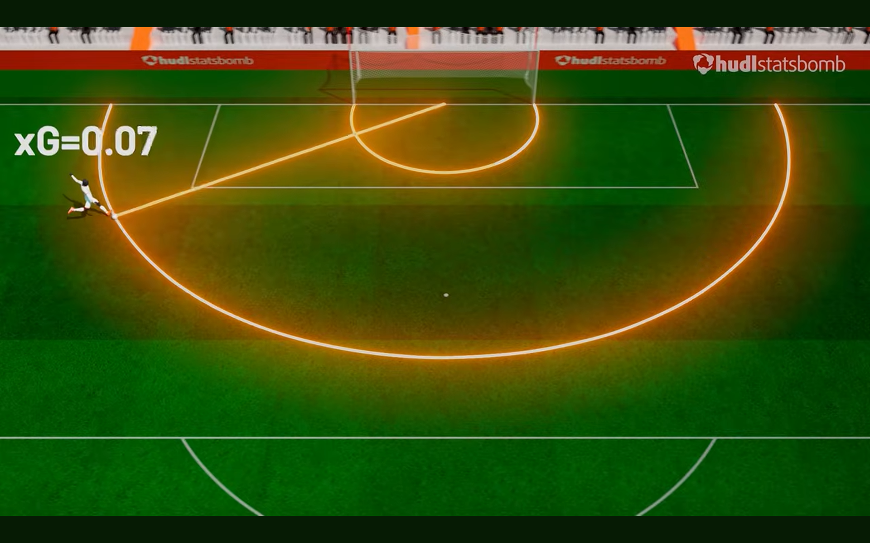
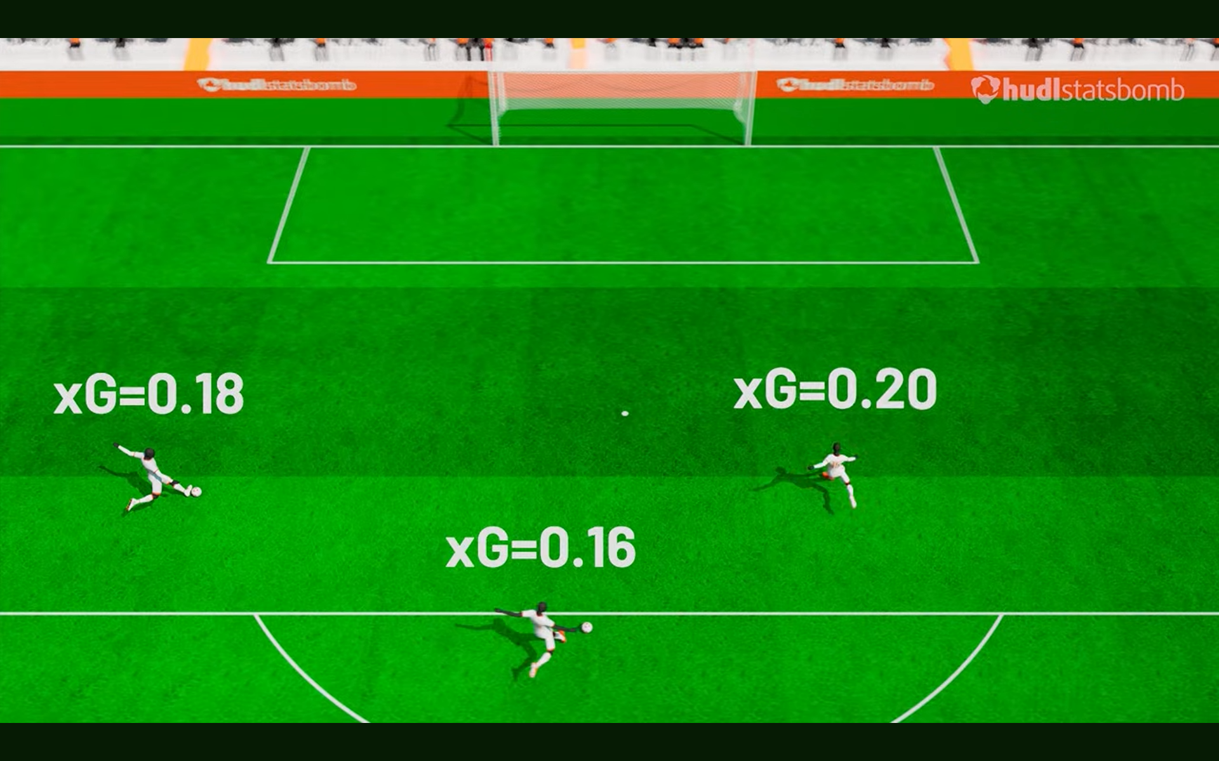
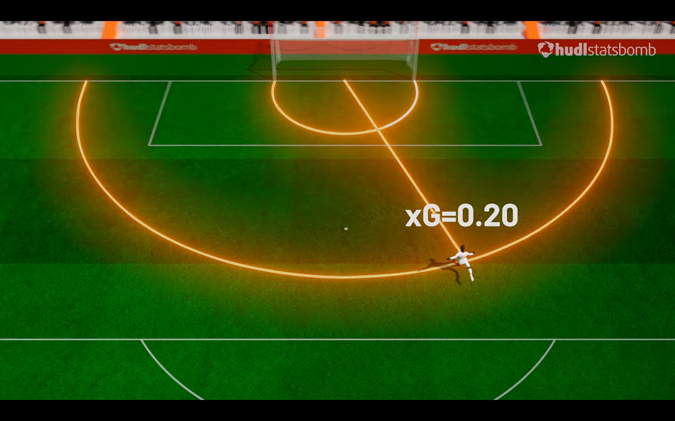
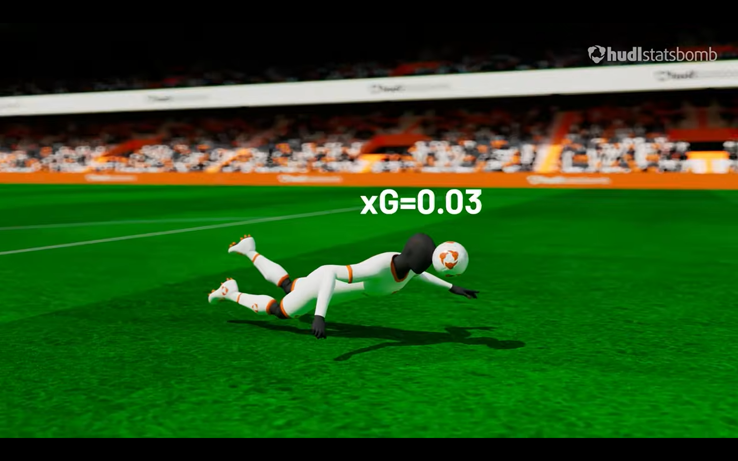
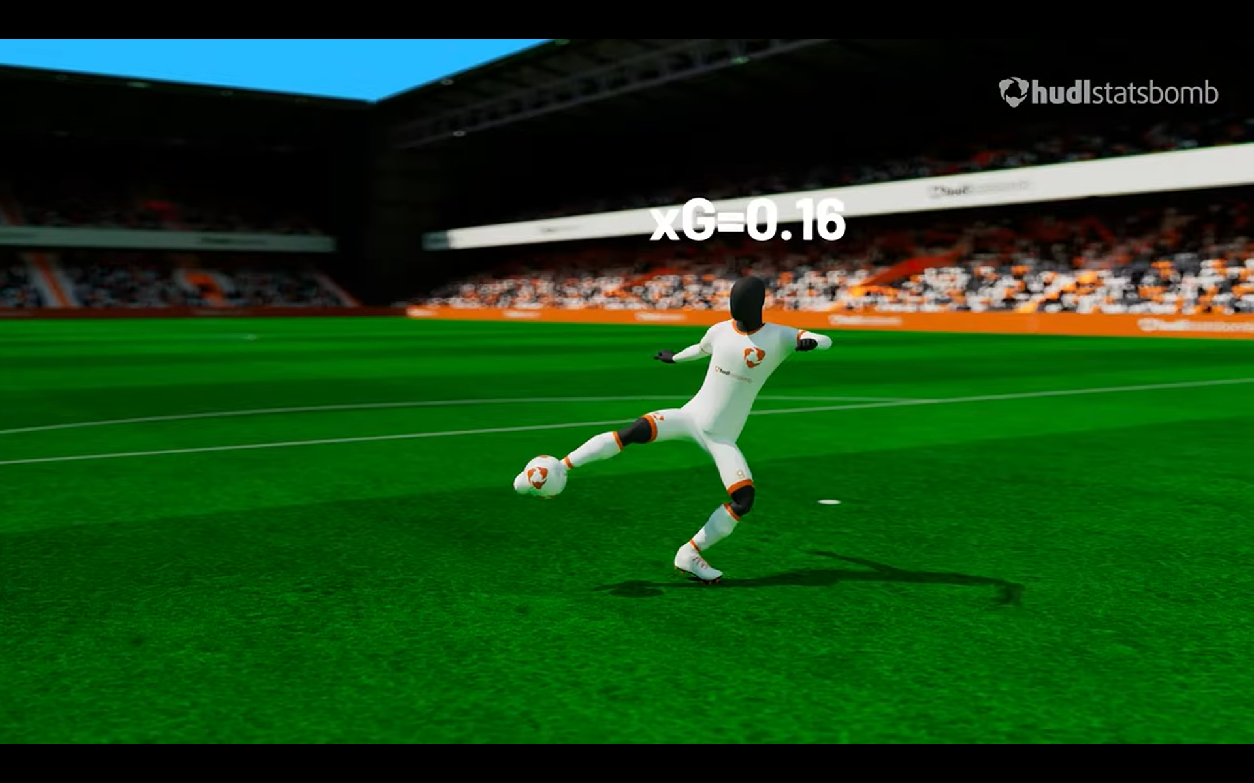
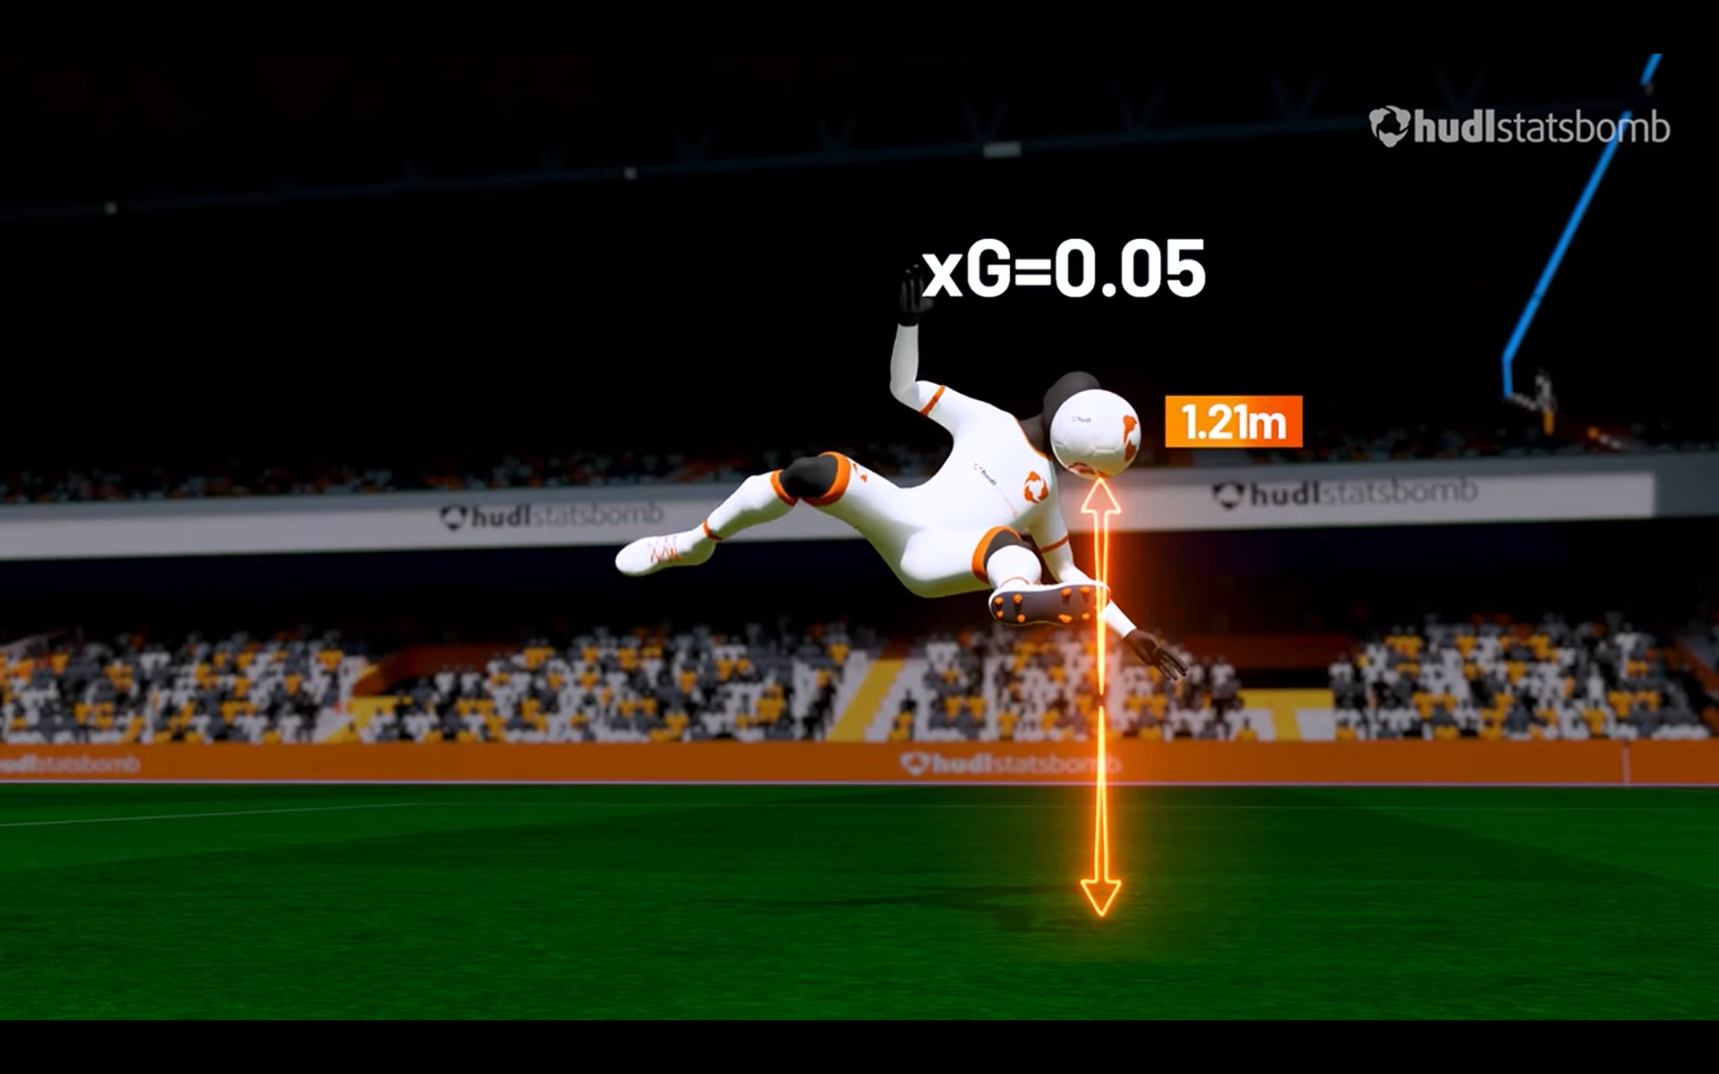
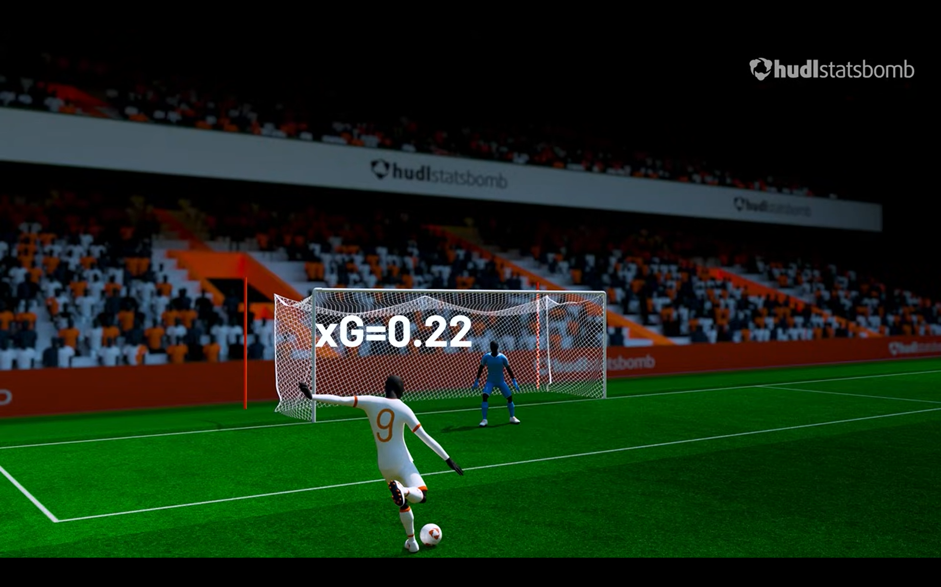
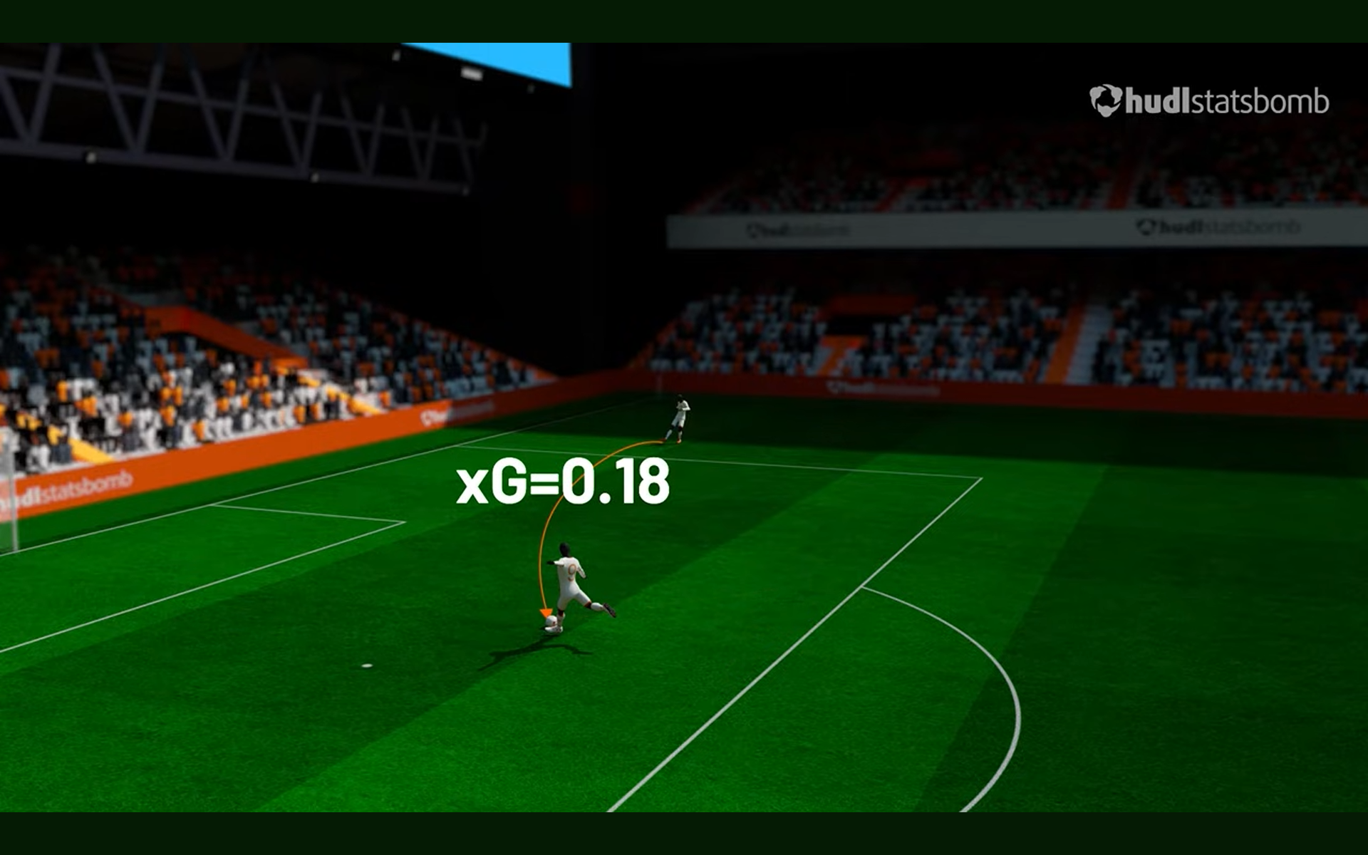
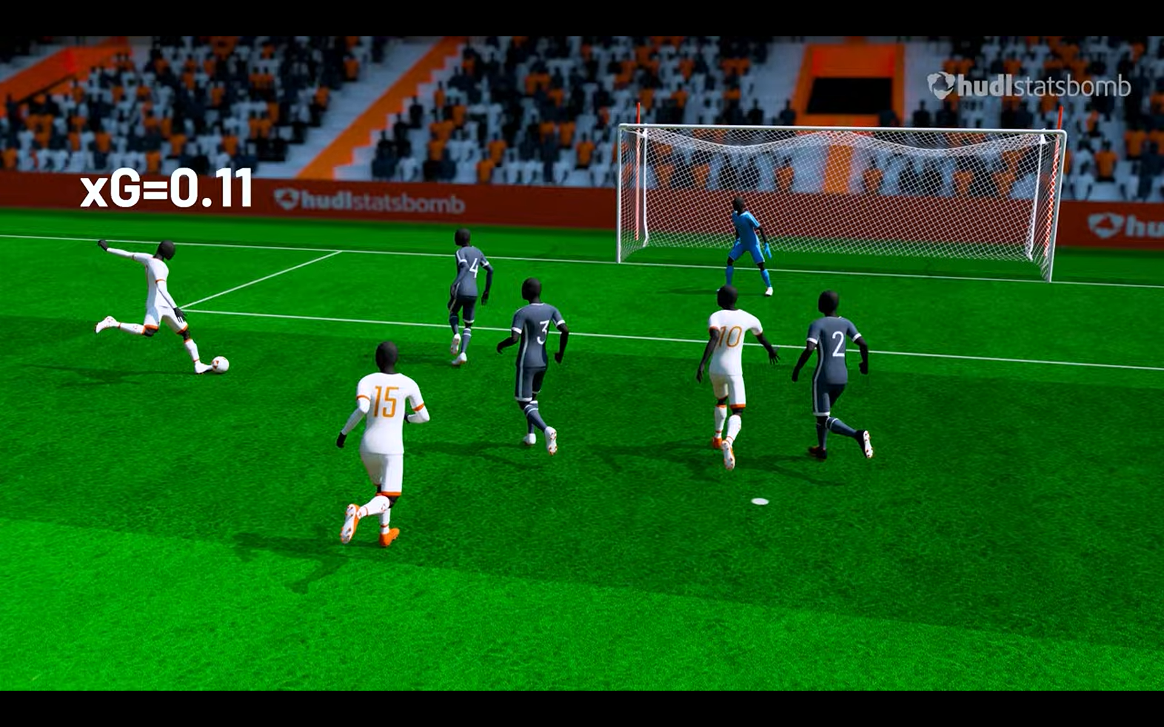

Slide 6
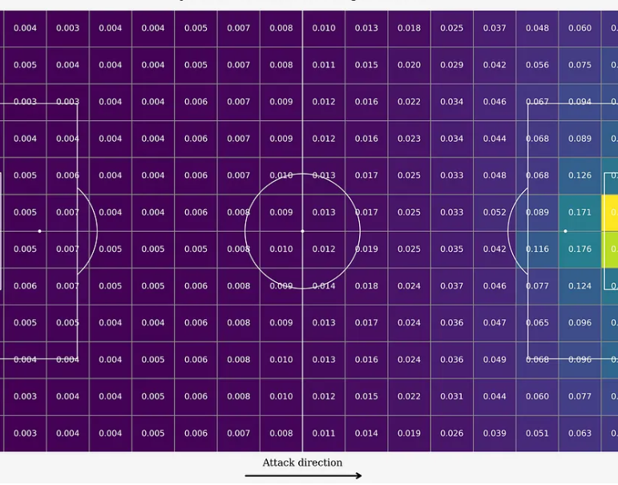
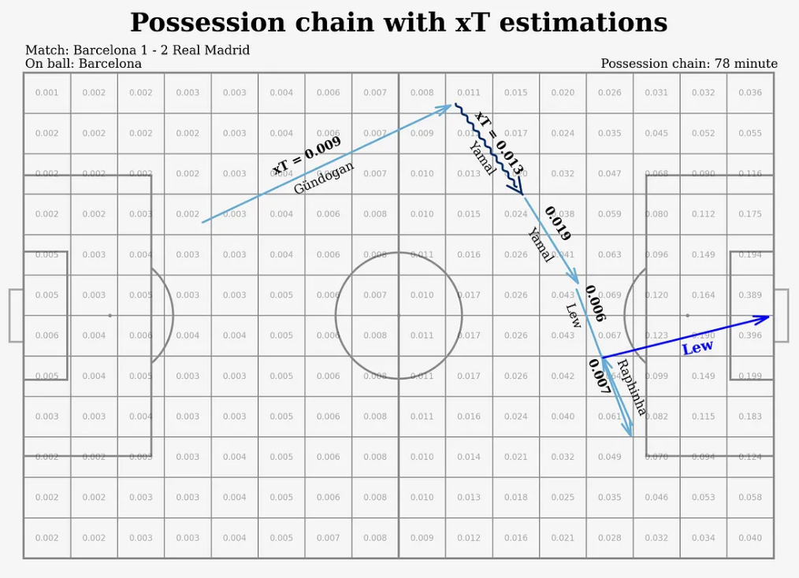
xT (expected threat)

Slide 7

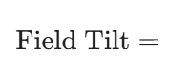
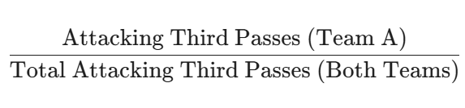
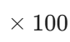
Field tilt
A metric used to measure territorial dominance by calculating the share of passes made in the attacking third compared to the total passes made in the attacking third by both teams.

Slide 8
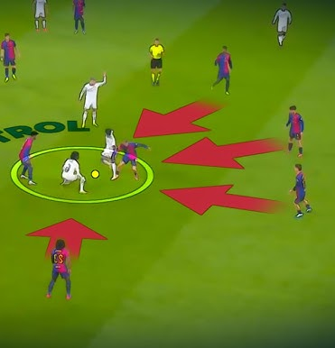
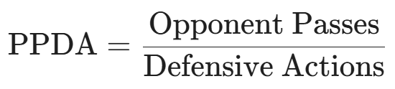
PPDA
Quantify the intensity of a team’s high press by calculating how many passes the opposition is allowed to make before a defensive intervention occurs.

Slide 9

Premier League Tactical Identity & Evolution (21–25)
The Story
A imagem Esta Fotografia de Autor Desconhecido está licenciada ao abrigo da CC BY-SA

Slide 10
KEY TAKEAWAYS
Identity Matters But don't give in to pride. Give in to the data.
“Attack wins you games, defense wins you titles.” Really? Which came first, the chicken or the egg?
It’s the territory, stupid! It's not about possession, it's not about pressure, it's about conquering and dominating territory.
Consistency is not that easy Being extraordinary is the exception.
We already know what it is. Can we find out how? The Midas touch is still human.
Notes:
Introdução à Premier League e à Importância dos Dados Estatísticos Principais Estatísticas Coletivas das Equipas Destaques Individuais: Jogadores em Evidência Tendências e Curiosidades Baseadas em Dados Utilização dos Dados para Previsões e Análises Futuras

Slide 11
Thank you all

